Slide 1

Political Ideology Detection Using BERT and CNN
Ben Sukboontip

Slide 2
Motivation
Biases in media creates polarization
Social media algorithm feeds us with information biased towards us
Need an autonomous way of determining political leanings of articles online
Show that titles can create an accurate model to determine political leanings of news articles

Slide 3
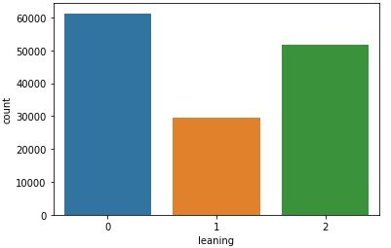
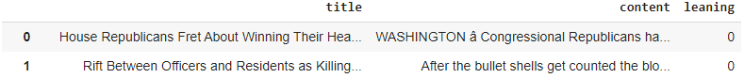
Dataset Construction
Imported articles from Kaggle’s “All the news” dataset containing 143,000 articles from 15 American publications
Political leanings of each article is based on its publication’s rating on AllSides.com

Slide 4
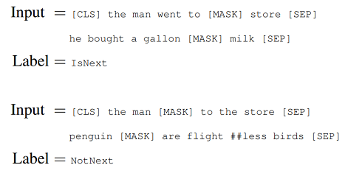
Pre-trained BERT Model
Bidirectional Encoder Representations from Transformers
1. Masked Language Model
2. Next Sentence Prediction

Slide 5
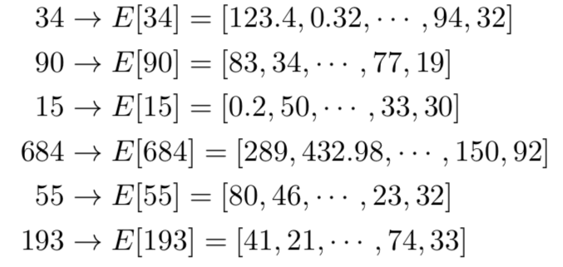
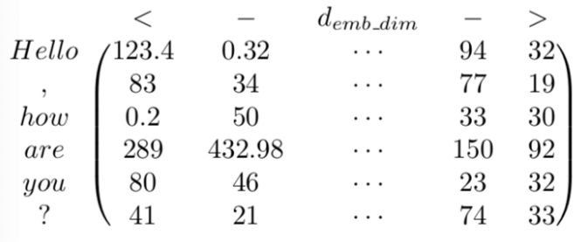
Text Encoding

Slide 6
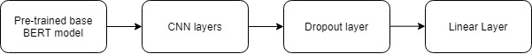
BERT Fine-Tuning
Transfer learning on pre-trained base BERT model

Slide 7
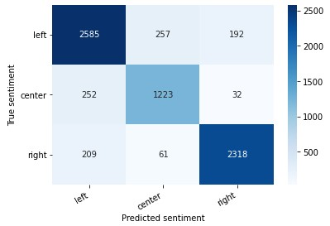
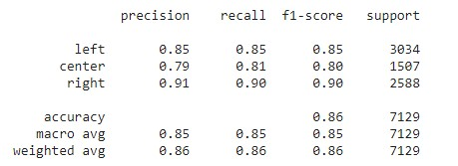
Evaluation of Results

Slide 8
Take-Home Message
Political leanings can be determined without even needing to read the content of the articles themselves
Titles can help models learn more about political ideologies of news articles

